Slide 1
CS 7375 Artificial Intelligence Spring 2022 Instructor: Xinyue Zhang
Lecture 5

Slide 2
Outline
Review of Lecture 4
Tree Structure
Backtracking Algorithm
Depth-first search (DFS)
Breadth-first search (BFS)
Depth-limited search
Iterative deepening depth-first search
Conclusions

Slide 3
Warmup Question
A farmer wants to get his cabbage, goat, and wolf across a river. He has a boat that only holds two. He cannot leave the cabbage and goat alone or the goat and wolf alone. How many river crossings does he need?
4
5
6
7
no solution
Notes:
When you solve this problem, try to think about how you did it. You probably simulated the scenario in your head, trying to send the farmer over with the goat and observing the consequences. If nothing got eaten, you might continue with the next action. Otherwise, you undo that move and try something else.
But the point is not for you to be able to solve this one problem manually. The real question is: How can we get a machine to do solve all problems like this automatically? One of the things we need is a systematic approach that considers all the possibilities. We will see that search problems define the possibilities, and search algorithms explore these possibilities.

Slide 4
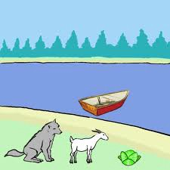
Boat Crossing a River
Farmer, Cabbage, Goat, Wolf
Actions:
F→, F←
FC→, FC←
FG→, FG←
FW→, FW←
Cost: Assume every crossing cost 1.
Approach: build a search tree!

Slide 5
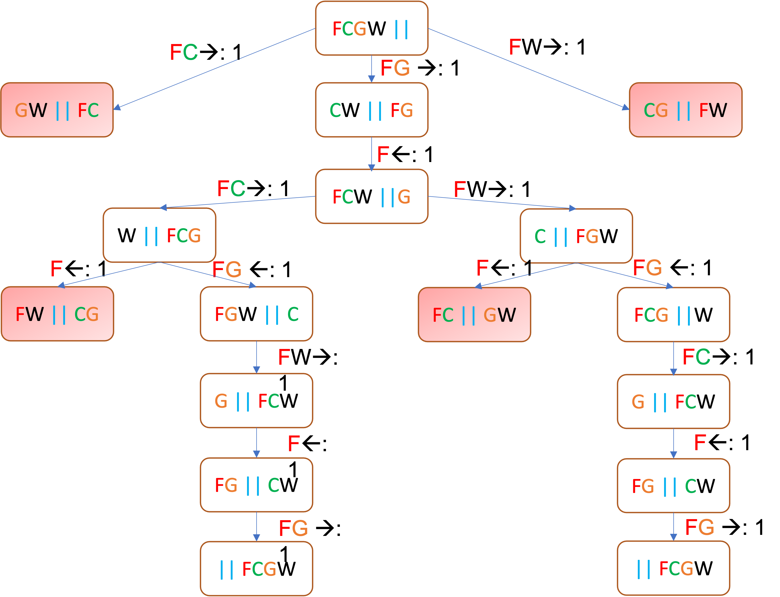

Search Problem
successor
Definition: search problem
s_{start}: starting state
Actions(s): possible actions
Cost(s, a): action cost
Succ(s, a): successor
IsEnd(s): reached end state?
1
1
1

Slide 6
Tree Search Algorithm
Basic idea:
offline, simulated exploration of state space
by generating successors of already-explored states (a.k.a. expanding states)
function Tree-Search( problem, strategy) returns a solution, or failure
initialize the search tree using the initial state of problem
loop do
if there are no candidates for expansion then return failure
choose a leaf node for expansion according to strategy
if the node contains a goal state then return the corresponding solution
else expand the node and add the resulting nodes to the search tree
end

Slide 7

Transportation Example
Street with blocks numbered 1 to n.
Walking from s to s +1 takes 1 minute.
Taking a magic tram from s to 2s takes 2 minutes.
How to travel from 1 to n in the least time?
1
2
3
4
5
6
7
8
…
1 minute
2 minutes
*Code available on D2L

Slide 8
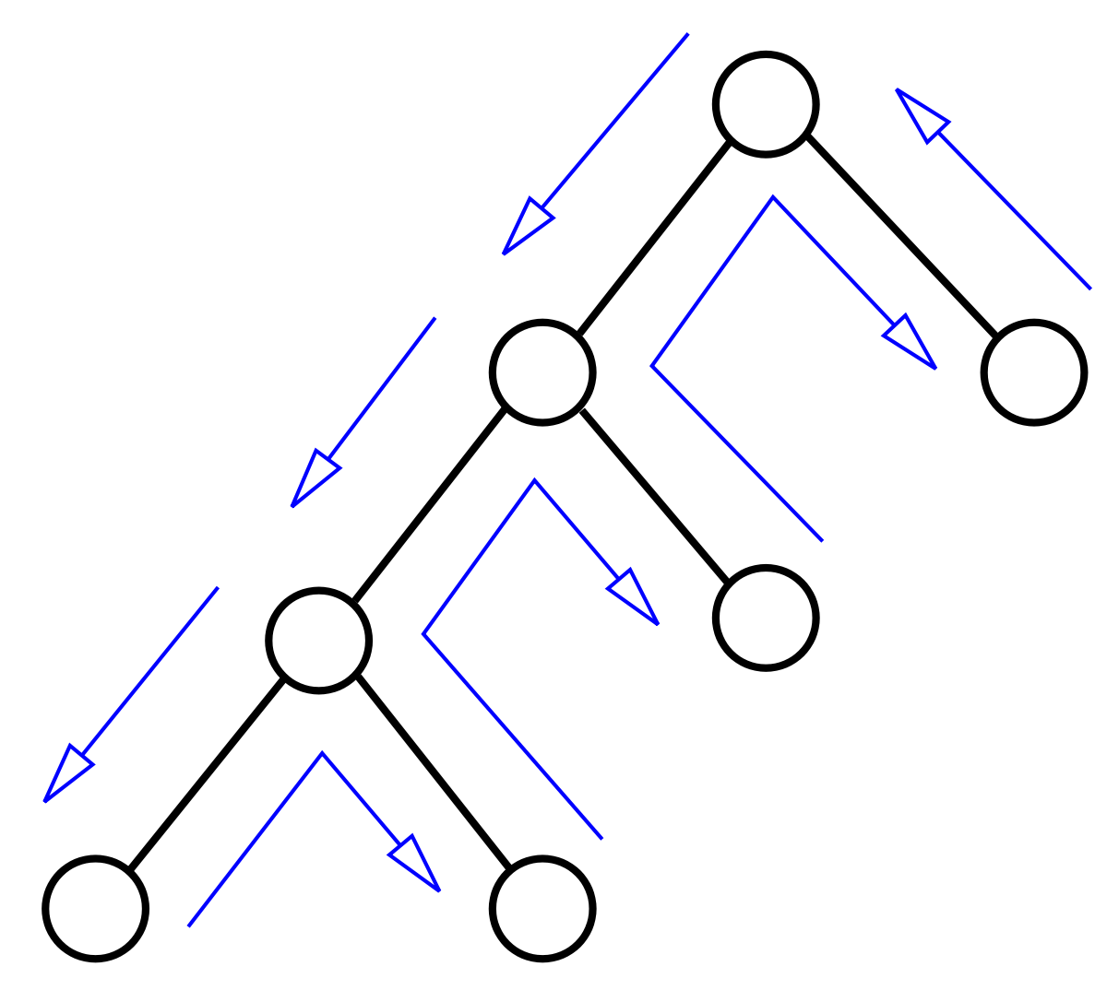
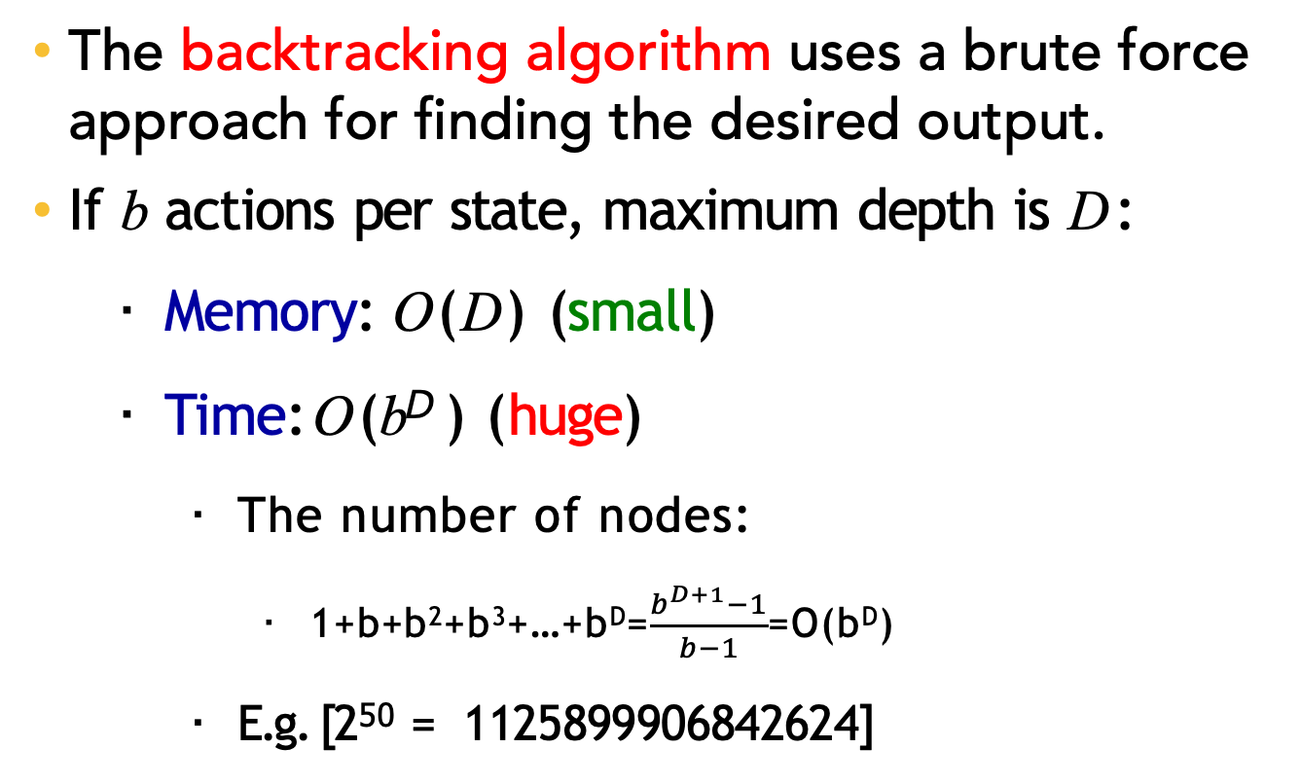
Backtracking Search
The backtracking algorithm uses a brute force approach for finding the desired output.
If b actions per state, maximum depth is D:
Memory: O(D) (small)
Time: O(b^{D} ) (huge)
The number of nodes:
1+b+b²+b³+…+b^{D}=$\frac{b^{D+1}−1}{b−1}$=O(b^{D})
E.g. [2⁵⁰ = 1125899906842624]

Slide 9
Backtracking Search
def backtrackingSearch(s, path):
If IsEnd(s): update minimum cost path For each action a ∈ Actions(s):
Extend path with Succ(s, a) and Cost(s, a) Call backtrackingSearch(Succ(s, a), path)
Return minimum cost path

Slide 10
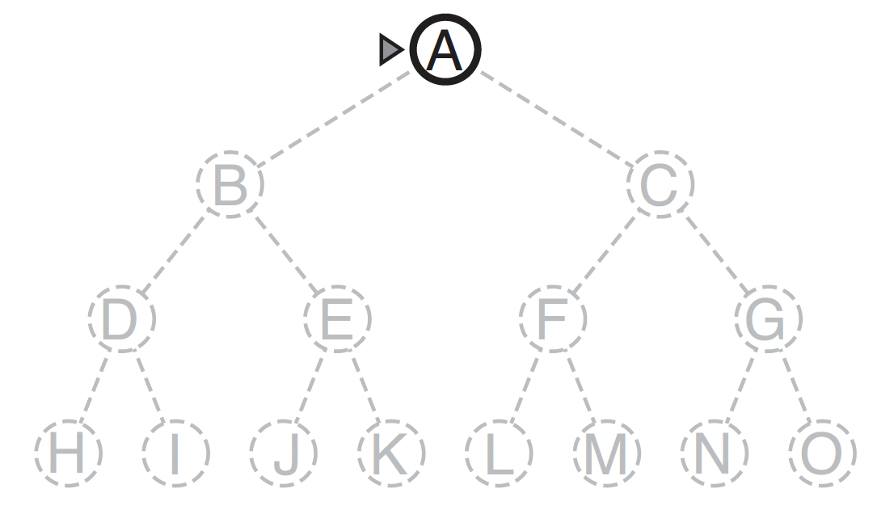
Depth-first search (DFS)
Depth-first search always expands the deepest node in the current frontier of the search tree.

Slide 11
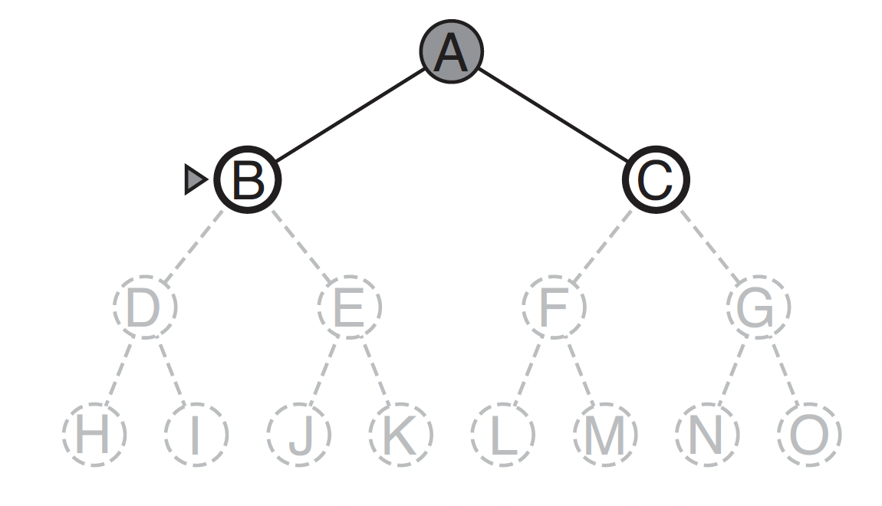
Depth-first search (DFS)
Depth-first search always expands the deepest node in the current frontier of the search tree.

Slide 12
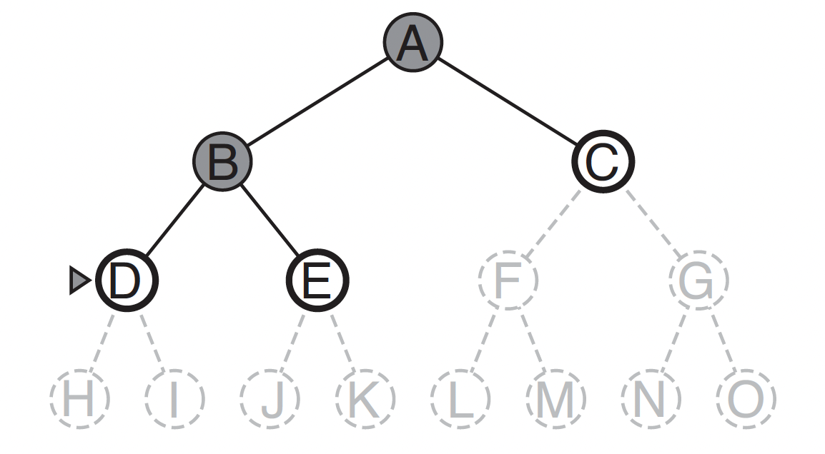
Depth-first search (DFS)
Depth-first search always expands the deepest node in the current frontier of the search tree.

Slide 13
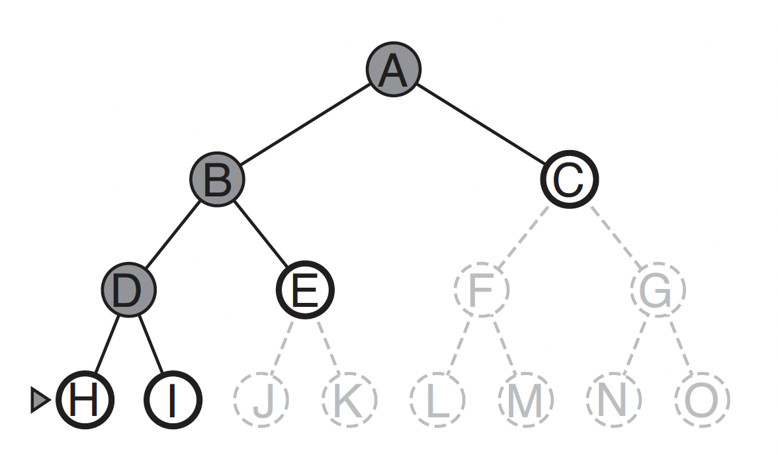
Depth-first search (DFS)
Depth-first search always expands the deepest node in the current frontier of the search tree.

Slide 14
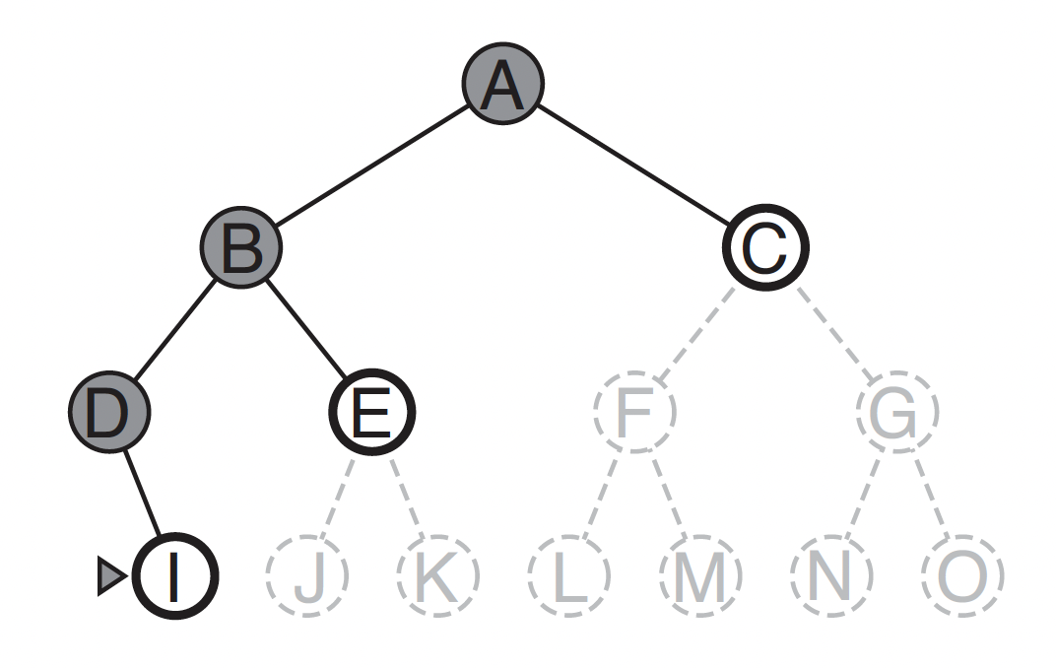
Depth-first search (DFS)
Depth-first search always expands the deepest node in the current frontier of the search tree.

Slide 15
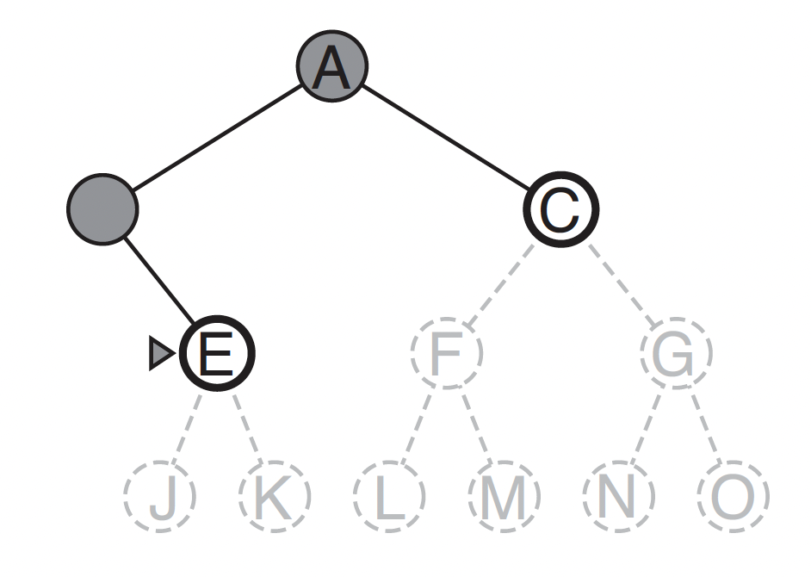
Depth-first search (DFS)
Depth-first search always expands the deepest node in the current frontier of the search tree.

Slide 16
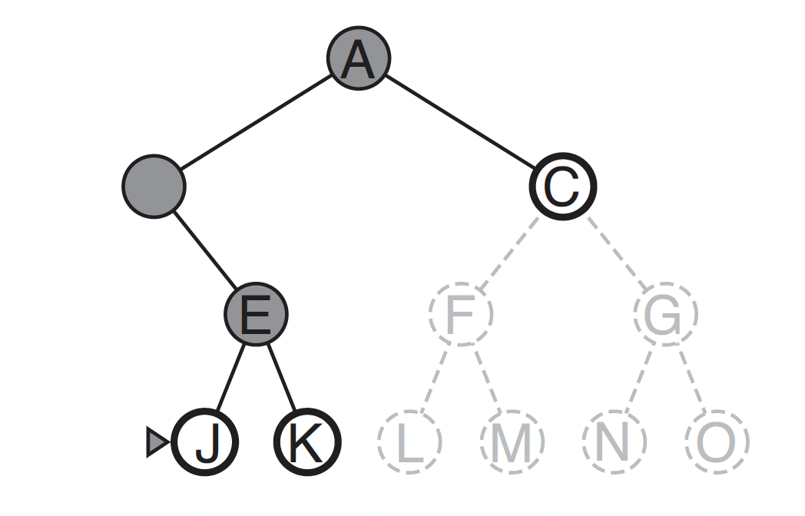
Depth-first search (DFS)
Depth-first search always expands the deepest node in the current frontier of the search tree.

Slide 17
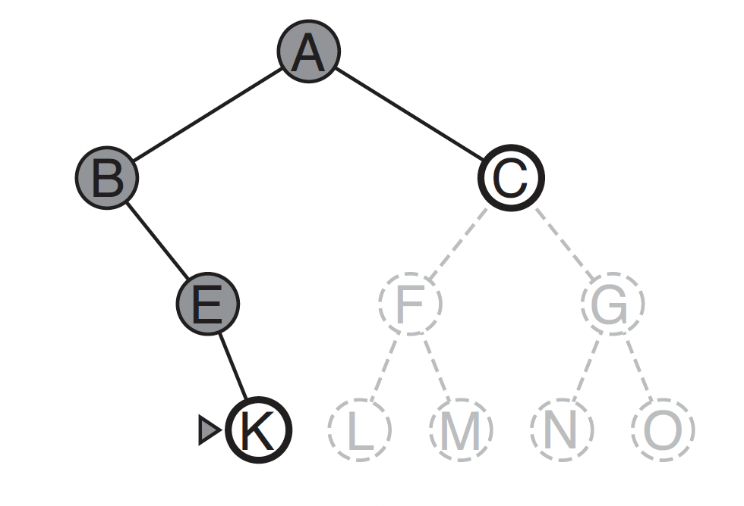
Depth-first search (DFS)
Depth-first search always expands the deepest node in the current frontier of the search tree.

Slide 18
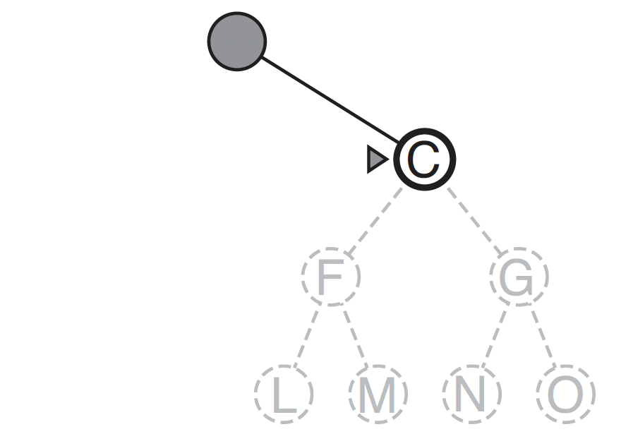
Depth-first search (DFS)
Depth-first search always expands the deepest node in the current frontier of the search tree.

Slide 19
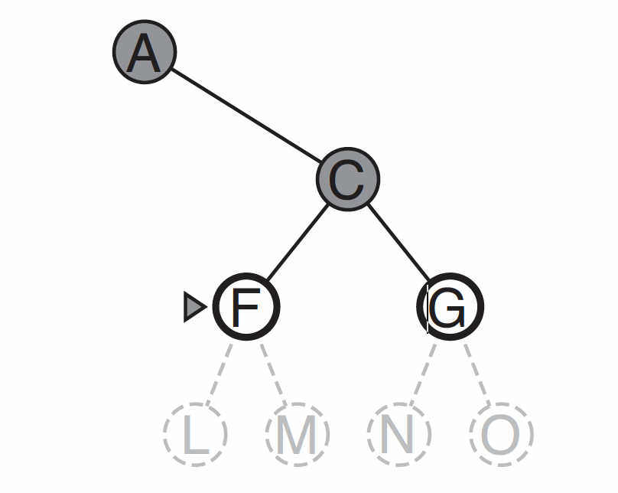
Depth-first search (DFS)
Depth-first search always expands the deepest node in the current frontier of the search tree.

Slide 20
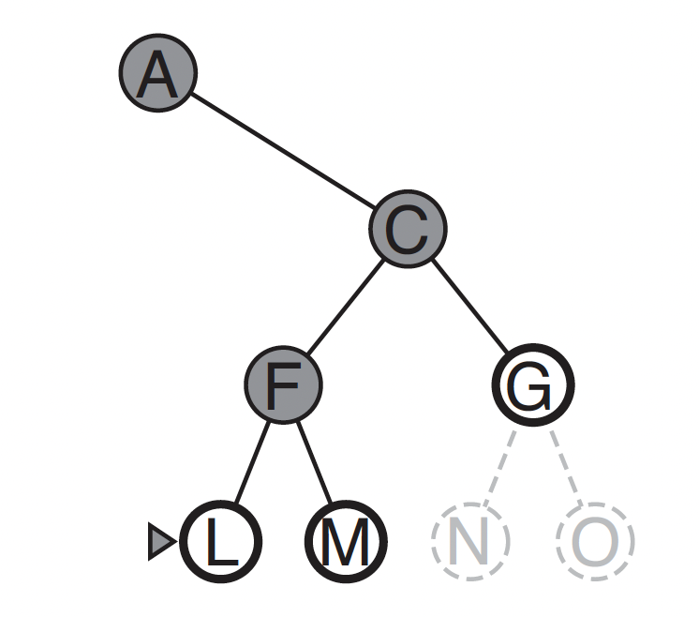
Depth-first search (DFS)
Depth-first search always expands the deepest node in the current frontier of the search tree.

Slide 21
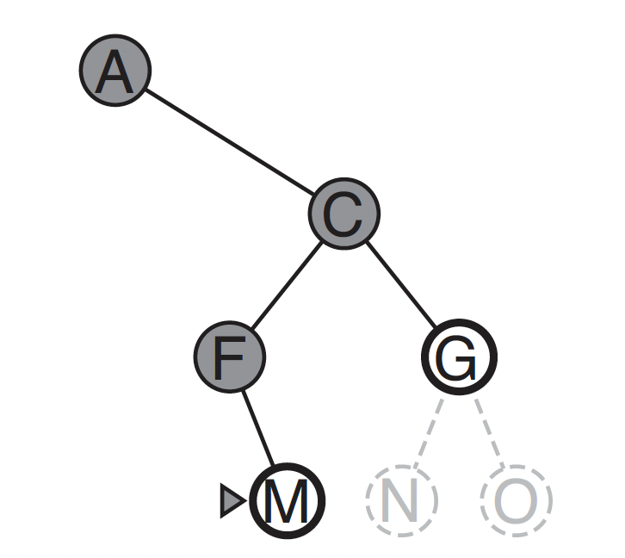
Depth-first search (DFS)
Depth-first search always expands the deepest node in the current frontier of the search tree.
The only goal node

Slide 22

Depth-first search (DFS)
Assumption: zero action costs
Assume action costs Cost(s, a) = 0.
Idea: Backtracking search + stop when find the first end state. If b actions per state, maximum depth is D:
Space: still O(D)
Time: still O(b^{D} ) worst case, but could be much better if solutions are easy to find

Slide 23
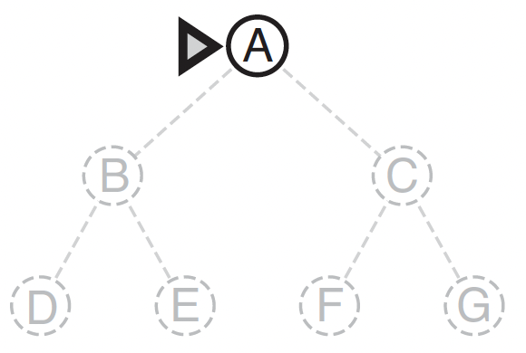
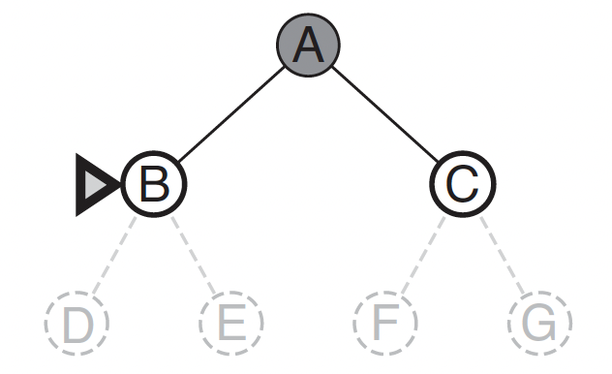
Breadth-first search (BFS)
Breadth-first search is a simple strategy in which the root node is expanded first, then all the successors of the root node are expanded next, then their successors, and so on.

Slide 24
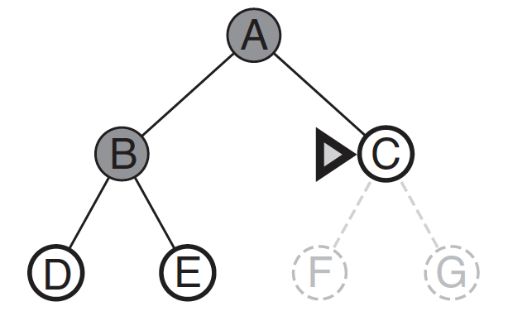
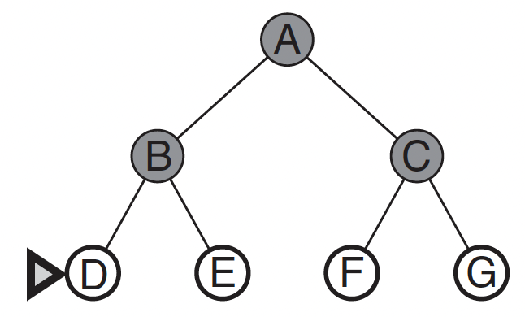
Breadth-first search (BFS)
Breadth-first search is a simple strategy in which the root node is expanded first, then all the successors of the root node are expanded next, then their successors, and so on.

Slide 25
Breadth-first search (BFS)
Assumption: constant/nondecreasing
action costs
E.g. Assume action costs Cost(s, a) = c for some c ≥ 0.
Idea: explore all nodes in order of increasing depth.
Legend: b actions per state, solution is at the depth d
Space: now O(b^{d}) (a lot worse!)
Time: O(b^{d}) (better, depends on d, not D)

Slide 26
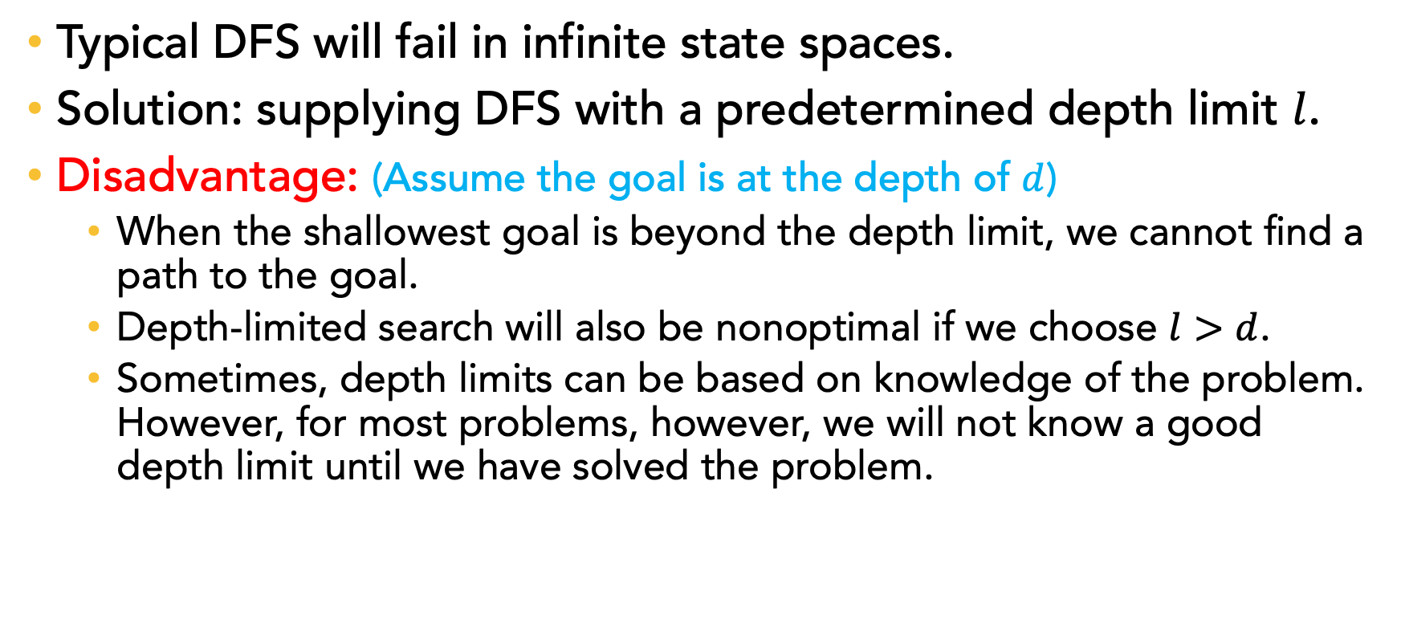
Depth-limited search
Typical DFS will fail in infinite state spaces.
Solution: supplying DFS with a predetermined depth limit $l$.
Disadvantage: (Assume the goal is at the depth of $d$)
When the shallowest goal is beyond the depth limit, we cannot find a path to the goal.
Depth-limited search will also be nonoptimal if we choose $l>d$.
Sometimes, depth limits can be based on knowledge of the problem. However, for most problems, however, we will not know a good depth limit until we have solved the problem.

Slide 27
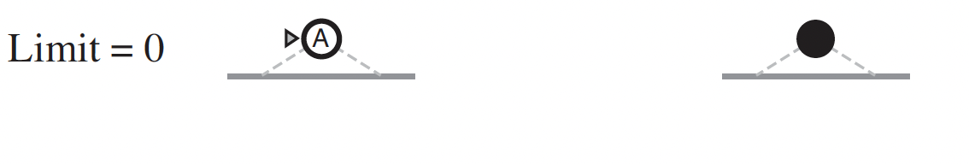
Iterative deepening depth-first search
Iterative deepening search (or iterative deepening DFS) is a general strategy, that finds the best depth limit.
It does this by gradually increasing the limit—first 0, then 1, then 2, and so on—until a goal is found.

Slide 28
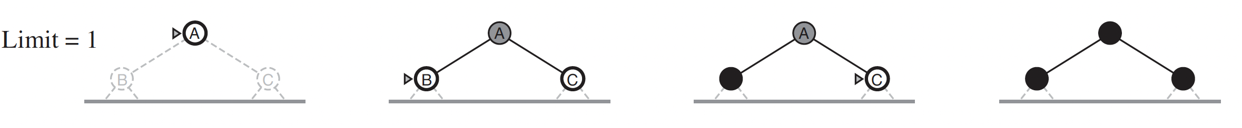
Iterative deepening depth-first search
Iterative deepening search (or iterative deepening DFS) is a general strategy, that finds the best depth limit.
It does this by gradually increasing the limit—first 0, then 1, then 2, and so on—until a goal is found.

Slide 29
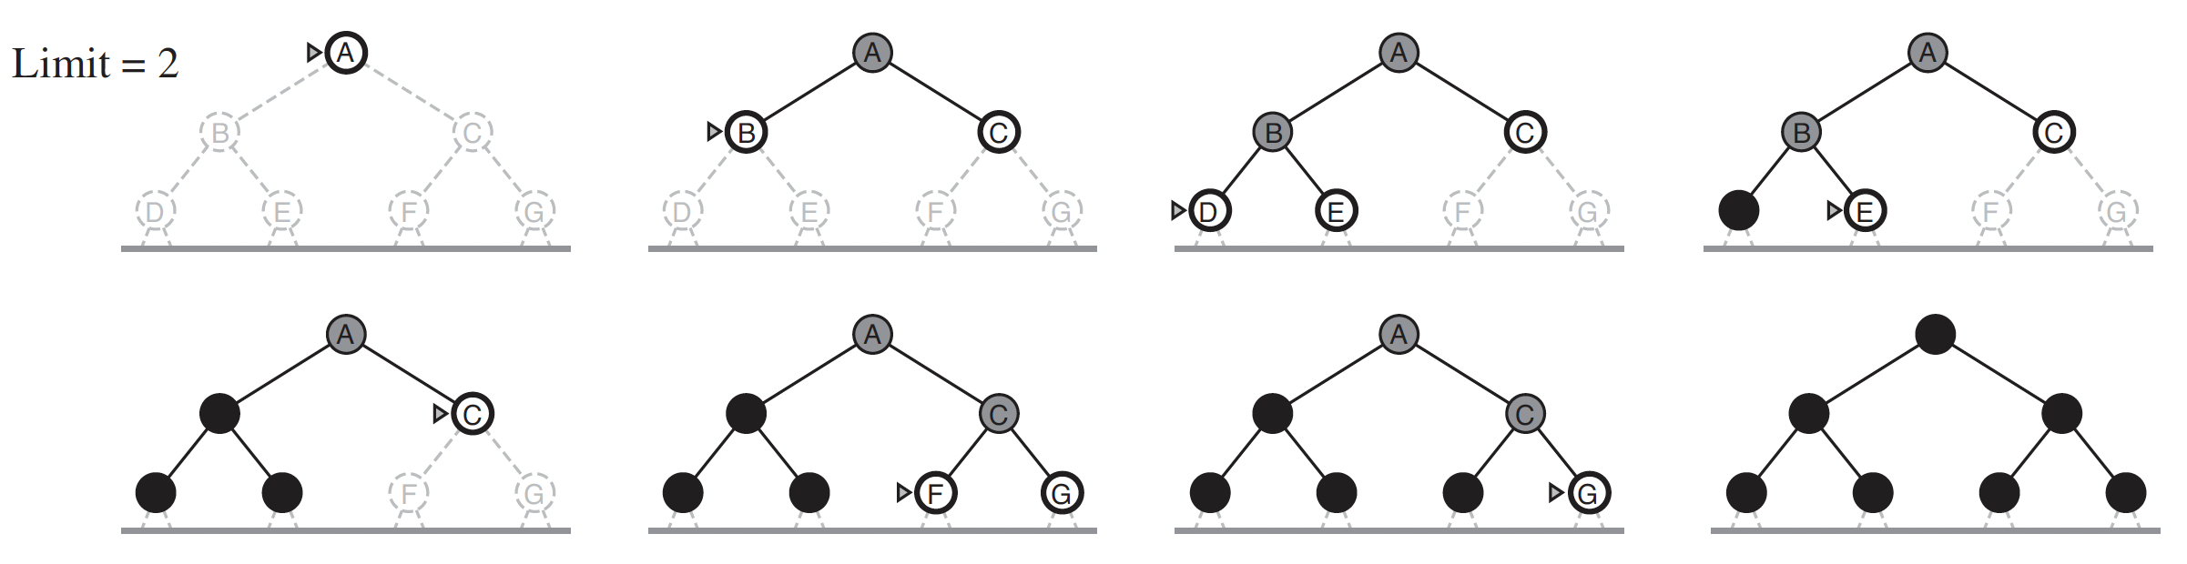
Iterative deepening depth-first search
Iterative deepening search (or iterative deepening DFS) is a general strategy, that finds the best depth limit.
It does this by gradually increasing the limit—first 0, then 1, then 2, and so on—until a goal is found.

Slide 30
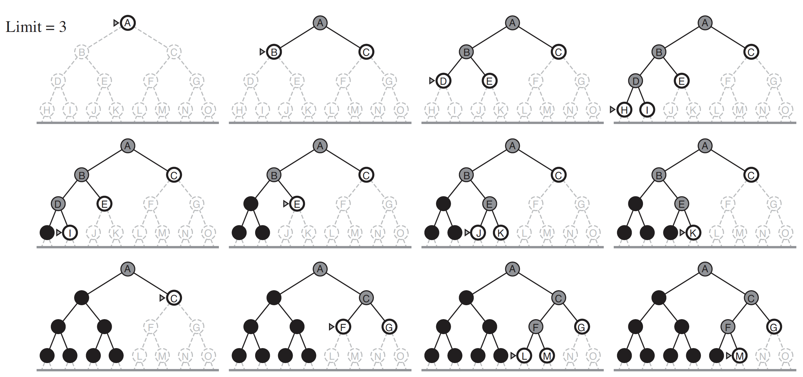
Iterative deepening depth-first search

Slide 31
Iterative deepening depth-first search
Assumption: constant/nondecreasing action costs
Assume action costs Cost(s, a) = c for some c ≥ 0.
Idea:
Modify DFS to stop at a maximum depth.
Call DFS for maximum depths 1, 2, . . . .
DFS on d asks: is there a solution with d actions?
Legend: b actions per state, solution size d
Space: O(d) (saved!)
Time: O(b^{d}) (same as BFS)

Slide 32
Tree search algorithms summary
Legend: b actions/state, solution depth d, maximum depth D
Algorithm | Action costs | Space complexity | Time complexity
Backtracking | any | O(D) | O(b^{D})
DFS | zero | O(D) | O(b^{D}) worst case
BFS | Constant ≥0 | O(b^{d}) | O(b^{d})
Iterative deepening DFS | Constant ≥0 | O(d) | O(b^{d})

Slide 33
Conclusions
Understand and be able to implement the following search algorithms
Backtracking Search Algorithm
Depth-first search (DFS)
Breadth-first search (BFS)
Depth-limited search
Iterative deepening depth-first search
Code is available on D2L

Slide 34

Email: xzhang48@kennesaw.edu
Teams: Xinyue Zhang (xzhang48)

